Slide 1
PSY 221B
One-Way ANOVA

Slide 2
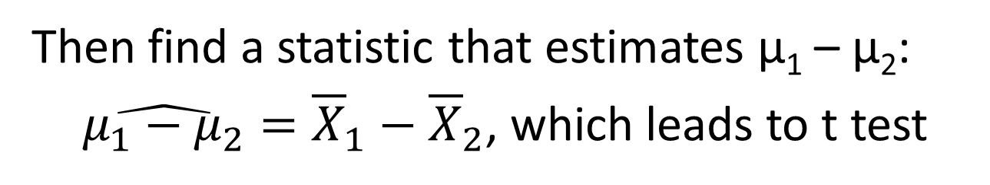
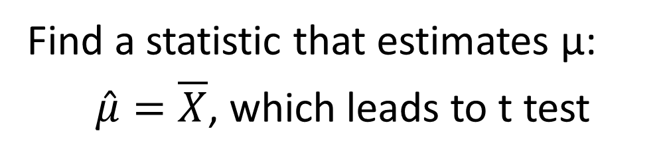
Null hypothesis significance testing
How do we test:
H₀: μ = 100
H₁: μ > 100
Find a statistic that estimates μ:
$\hat{μ}=\overline{X}$, which leads to t test
How do we test:
H₀: μ₁ = μ₂
H₁: μ₁ ≠ μ₂
H₀: μ₁ – μ₂ = 0
H₁: μ₁ – μ₂ ≠ 0
Rewrite hypotheses as:
Then find a statistic that estimates μ₁ – μ₂:
$\hat{μ_{1}−μ_{2}}={\overline{X}}_{1}−$ ${\overline{X}}_{2}$, which leads to t test

Slide 3
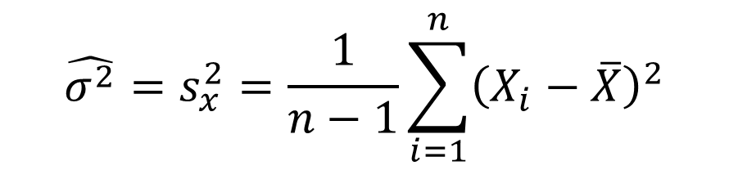
Null hypothesis significance testing
Find a statistic that estimates σ² :
which leads to χ² test
How do we test:
H₀: σ² = 100
H₁: σ² > 100
$${\hat{σ^{2}}=s}_{x}^{2}=\frac{1}{n−1}\sum_{i=1}^{n}{{\left(X_{i}−\overline{X}\right)}^{2}}$$

Slide 4
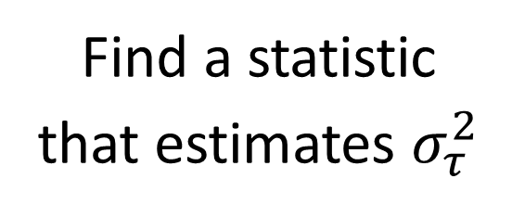
One-Way ANOVA
How do we test:
H₀: τ₁ = τ₂ = … τ_{p}
H₁: not H₀
Find a statistic
that estimates $σ_{τ}^{2}$
Rewrite hypotheses as:

Slide 5
Step 1. How do we estimate σ_{τ}²?
Remember that:
So how about: ?
could be large because of treatment effect or because of individual differences.
OK. But biased.

Slide 6
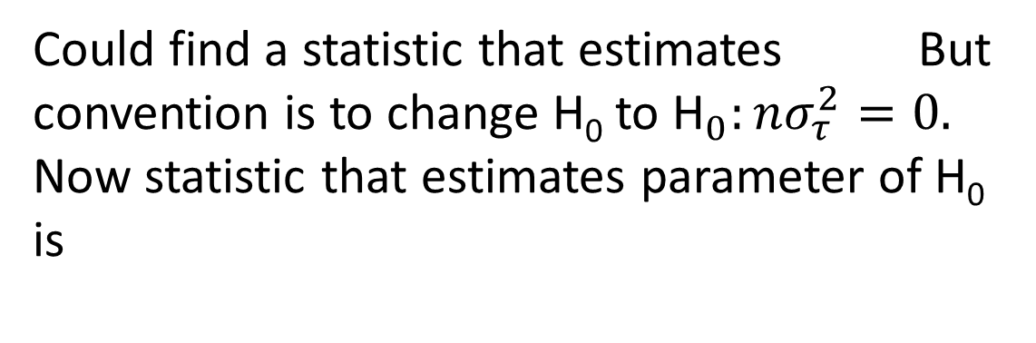
So we need to correct for bias.
Could find a statistic that estimates But convention is to change H₀ to ${\text{H}}_{0}:nσ_{τ}^{2}=0.$
Now statistic that estimates parameter of H₀ is
Note that
which is also large because of a treatment effect or because of individual differences. Now bias term is

Slide 7
Step 2. How do we estimate σ_{ϵ}²?
Recall that in Fisher’s 2-sample t-test with independent samples:
So
so unbiased.

Slide 8
Step 3. Put them together
Could try:
1) MST – MSE; or 2) MST/MSE
MST/MSE has a known distribution, so:
~
Decision Rule: Reject H₀ if F_{obs} > F_{.95}[p – 1, p(n – 1)]

Slide 9
Example
Suppose we are testing the efficacy of a new drug that is supposed to stimulate the dopamine system. We divide 16 Parkinson’s disease patients into two groups, and we run them and a younger adult control group in the Wisconsin Card Sorting Test.
T₁ = young adults
T₂ = PD patients on drug
T₃ = PD patients not on drug
DV = # of perseverative errors
n = 8
p = 3

Slide 10
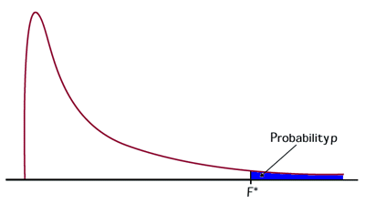
Example
n = 8
p = 3
SSE = SS1 + SS2 + SS3 = 86.88
Under H₀, F_{obs} ~ F(2, 21)
F_{obs} > F_{.95}(2, 21).
Therefore reject H₀.
.05
F_{.95}(2,21) = 3.47
At least one treatment mean is different from the others.

Slide 11
An alternative way to present results.
ANOVA Summary Table
Source of Variation | SS | df | MS | F
Treatments | SST | p – 1 | MST | MST/MSE
Error | SSE | p(n – 1) | MSE
Total | SS_{total} | pn – 1
SST + SSE = SS_{total}
df_{T} + df_{E} = df_{total}

Slide 12
Earlier Example
n = 8
p = 3
Source of Variation | SS | df | MS | F
Treatments | 50.17 | 2 | 25.04 | 6.05*
Error | 86.88 | 21 | 4.14
Total | 137.05 | 23

Slide 13
Assumptions
y_{ij} = µ + τ_{i} + ε_{ij}
ε_{ij} are all independent
ε_{ij} are all normally distributed
ε_{ij} all have same variance (homogeneity of variance)

Slide 14
Testing Homogeneity of Variance
Hartley F_{max} Test
Use small α to avoid type I error (not using ANOVA even though it is valid) because ANOVA is robust w.r.t. moderate violations of homogeneity of variance
Under the null hypothesis, the statistic:
has an F_{max} distribution with parameters p and n-1.
So reject H₀ if F_{max} observed > F_{max(.99)}(p, n – 1).

Slide 15
Earlier example
n = 8, p = 3
Observed F_{max} < F_{max(.99)}(3, 7)
So do not reject H₀

Slide 16
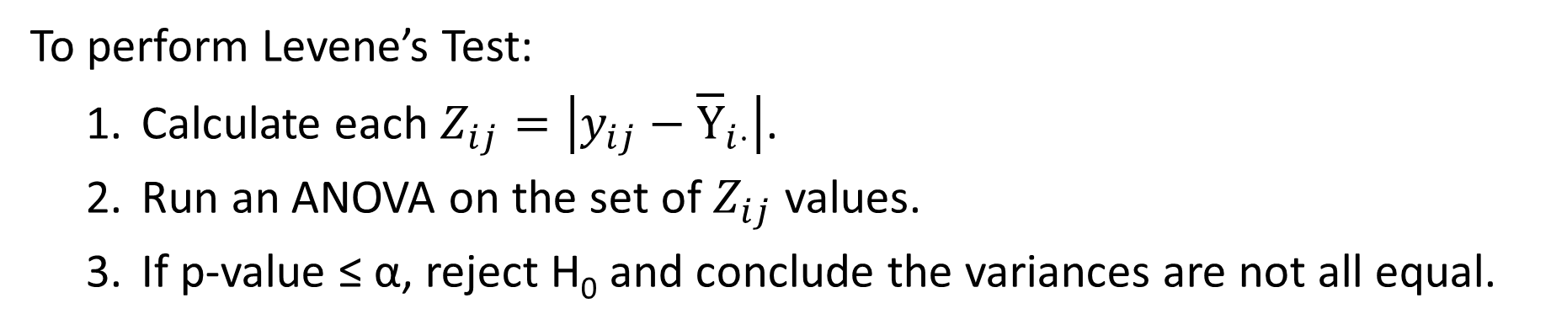
Testing Homogeneity of Variance
Levene’s Test
To perform Levene’s Test:
Calculate each $Z_{ij}=\left|y_{ij}−{\overline{\text{Y}}}_{i⋅}\right|$.
Run an ANOVA on the set of $Z_{ij}$ values.
If p-value ≤ α, reject H₀ and conclude the variances are not all equal.
F_{obs} = .783
F_{.99}(2, 21) = 5.78
So n.s.

Slide 17
Hypothesis Testing in ANOVA Designs
Step 1. Omnibus testing – testing for overall effects
If nothing is significant – Done!
Step 2. If some omnibus tests are significant, then further post-hoc testing is warranted.
Two types of post-hoc tests:
Exploratory (test everything)
vs
Confirmatory (also called planned comparisons; test specific hypotheses of theoretical interest)

Slide 18
Post-hoc testing
e.g., Consider the following one-way ANOVA omnibus tests
Source of Variation | SS | df | MS | F
Treatments | 676.8 | 6 | 112.8 | 9.4**
Error | 168 | 14 | 12.0
Total | 844.8 | 20
At least some of these 7 treatments had significantly different effects than others. Which ones were different?
In the absence of any specific hypotheses,
common to test all possible differences.

Slide 19
Post-hoc testing
So we want to test:
H₀: τ₁ = τ₂
H₁: τ₁ ≠ τ₂
H₀: τ₁ = τ₃
H₁: τ₁ ≠ τ₃
H₀: τ₁ = τ₄
H₁: τ₁ ≠ τ₄
21 tests in total
Question 1. Are these testable hypotheses?
Yes! Each one is a contrast.
Question 2. How do we set α?

Slide 20
Multiple Comparisons Problem
Let α_{t} = α level on each individual test
(probability of a Type I error on each test)
α_{E} = experiment-wise α level
(probability of at least one Type I error
in the family of tests)
Problem: Choose a value for α_{t} that guarantees α_{E} has some desired value.

Slide 21

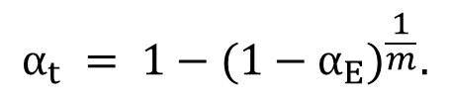




Sidak Correction for Multiple Comparisons
Assume we have m tests to perform and the outcome of each test is independent of the outcome of all other tests. Suppose the null hypothesis is true in all m tests.
The probability that each single test is correct is:
$$\left(1−α_{t}\right)$$
So the probability that all m tests are correct is:
$$P(\text{all} m \text{tests} \text{are} \text{correct}) =$$
$$(1−α_{t})^{m}$$
Therefore, the probability of at least one error (i.e., α_{E}) equals:
$$α_{E} =$$
$$1−(1−α_{t})^{m}$$
Solving for α_{t} produces the Sidak correction:
$$α_{t} = 1−(1−α_{E})^{\frac{1}{m}}.$$

Slide 22
Bonferroni Correction
Sidak correction:
Bonferroni noticed that a good approximation is:
e.g., suppose we want α_{E} = .10. Then we should set α_{t} to:
m | Sidak | Bonferroni
3 | .0345 | .0333
4 | .026 | .025
10 | .0105 | .01
21 | .005 | .00476
Yikes!
very small

Slide 23
Problems with Sidak/Bonferroni Corrections
The Sidak and Bonferroni corrections assume the outcome of each test is independent of the outcome of all other tests.
e.g., suppose the following hypothesis is rejected because is especially large.
H₀: τ₁ = τ₂
H₁: τ₁ ≠ τ₂
Then what does that tell us about the outcome of:
H₀: τ₁ = τ₃
H₁: τ₁ ≠ τ₃
Also likely to be rejected since its outcome also depends on

Slide 24
Problems with Sidak/Bonferroni Corrections
In ANOVA, post-hoc tests are correlated. As a result, Bonferroni corrections are too conservative – i.e., true α_{E} < α_{E} according to Bonferroni. Therefore, Bonferroni sets α_{t} too small.
Unfortunately, no exact solution to this problem. So a wide variety of alternatives exist that can be roughly ordered based on how conservative they are.
Bonferroni most conservative (most difficult to reject)
Scheffe
Tukey HSD
Newman-Keuls
Duncan most aggressive (easiest to reject)

Slide 25
Newman-Keuls
Step 1. Order the from smallest to largest.
e.g., in above example p = 7. Label the 7 treatments a, b, c, d, e, f, and g. Suppose ordering of means is as follows:
c a d b g e f
10 12 13 18 22 24 25
For each pair of ordered means, define the range of the pair, denoted r, as the number of ordered means between them including the endpoints.
e.g., r(c,a) = 2, r(c,b) = 4, r(c,f) = 7

Slide 26
Newman-Keuls
c a d b g e f
10 12 13 18 22 24 25
Step 2. Construct the matrix of ordered differences.
 | c | a | d | b | g | e | f | r | cv
c | ― | 2 | 3 | 8 | 12 | 14 | 15 | 7
a |  | ― | 1 | 6 | 10 | 12 | 13 | 6
d |  |  | ― | 5 | 9 | 11 | 12 | 5
b |  |  |  | ― | 4 | 6 | 7 | 4
g |  |  |  |  | ― | 2 | 3 | 3
e |  |  |  |  |  | ― | 1 | 2
f |  |  |  |  |  |  | ―
The 21 mean
differences we want
to assess for significance

Slide 27
Newman-Keuls
Step 3. Determine critical value for each test.
studentized range statistic
~
So decision rule is: reject H₀: τ_{i} = τ_{j} if
Duncan has own tabled values, which tend to be smaller than these.
or equivalently if
Easier, since right side is same for all pairs with the same value of r.

Slide 28
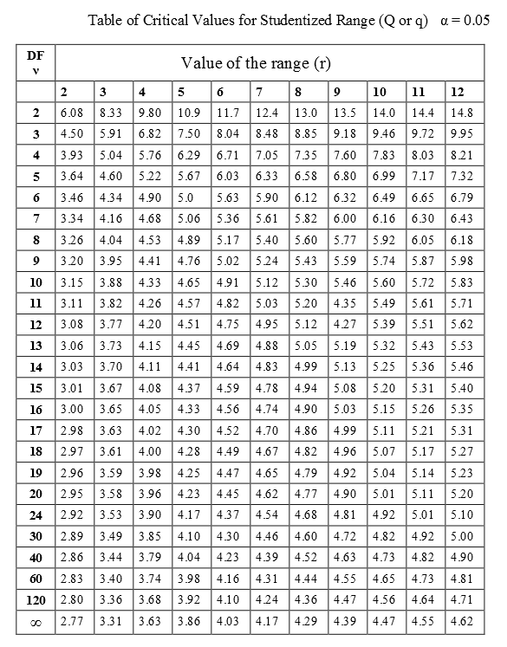
Newman-Keuls
Step 3. Determine critical value for each test.
cv for α_{E} = .05,
r = 7, p(n – 1) = 14

Slide 29
Newman-Keuls
Step 3. Determine critical value for each test.
 | c | a | d | b | g | e | f | r | cv
c | ― | 2 | 3 | 8 | 12 | 14 | 15 | 7 | 9.66
a |  | ― | 1 | 6 | 10 | 12 | 13 | 6 | 9.28
d |  |  | ― | 5 | 9 | 11 | 12 | 5 | 8.82
b |  |  |  | ― | 4 | 6 | 7 | 4 | 8.22
g |  |  |  |  | ― | 2 | 3 | 3 | 7.40
e |  |  |  |  |  | ― | 1 | 2 | 6.06
f |  |  |  |  |  |  | ―

Slide 30
Newman-Keuls
Step 3. Complete the tests. Begin with r = 7 and work down through lower r values.
Tukey HSD uses this value for all tests
 | c | a | d | b | g | e | f | r | cv
c | ― | 2 | 3 | 8 | 12 | 14 | 15 | 7 | 9.66
a |  | ― | 1 | 6 | 10 | 12 | 13 | 6 | 9.28
d |  |  | ― | 5 | 9 | 11 | 12 | 5 | 8.82
b |  |  |  | ― | 4 | 6 | 7 | 4 | 8.22
g |  |  |  |  | ― | 2 | 3 | 3 | 7.40
e |  |  |  |  |  | ― | 1 | 2 | 6.06
f |  |  |  |  |  |  | ―
*
*
15 > 9.66,
so f > c
*
*
*
*
14 > 9.28,
so e > c
*
*
*
9 is only untested value not walled off. So only test left to do.
8 < 8.22,
so b – c ns.
Wall off the ns difference.

Slide 31
Planned Comparisons
Suppose we only want to test certain specific hypotheses that theory predicts are of special interest. For almost any ANOVA design and almost any theory, it will be possible to write the hypothesis in the form:
H₀: v’β = c
H₁: v’β ≠ c
For some vector of constants v, and some scalar constant c.

Slide 32
H₀: v’β = c
H₁: v’β ≠ c
Planned Comparisons
Question 1. Is the hypothesis testable?
1-way ANOVA & H₀ only includes τ’s?
Yes
No
Is it a contrast?
Does rank(X’X) = rank(X’X:v)?
No
Yes
Yes
No
testable
not testable

Slide 33
Planned comparisons – Is it a contrast?
universe of all possible ANOVA designs
1-way ANOVAs
1-way ANOVA hypotheses
that only include τ’s
Contrast test only guaranteed to work in here

Slide 34
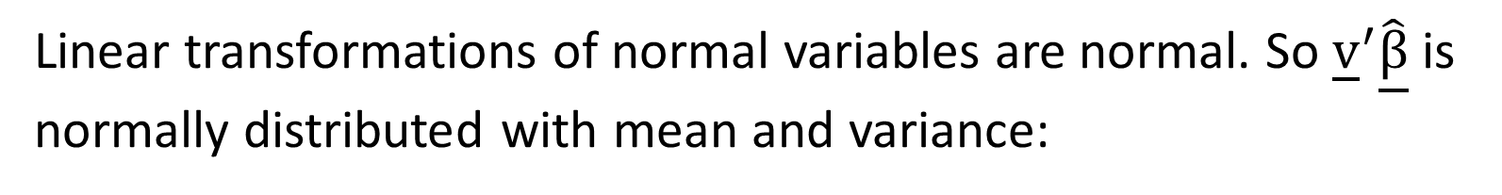
H₀: v’β = c
H₁: v’β ≠ c
Planned Comparisons
If testable, then estimate v’β with , where comes from any solution of the normal equations.
Now
Note that is a linear transformation of y and of order
1 × 1.
Linear transformations of normal variables are normal. So ${\underline{\text{v}}}^{′}\underline{\hat{\text{β}}}$ is normally distributed with mean and variance:

Slide 35
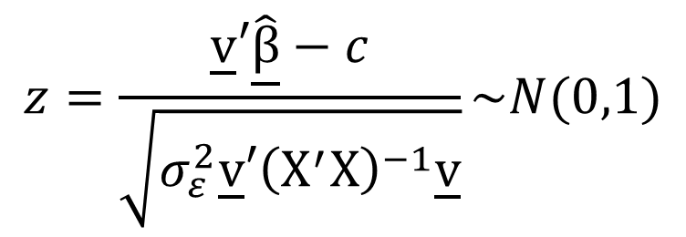
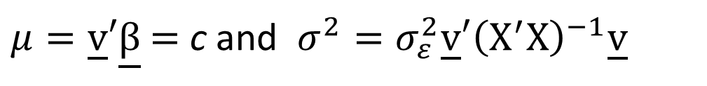
H₀: v’β = c
H₁: v’β ≠ c
Planned Comparisons
If
is normally distributed with mean and variance:
$μ=\underline{\text{v}}′\underline{\text{β}}$ $=$ c and $σ^{2}=σ_{ε}^{2}\underline{\text{v}}′{\left({\text{X}}^{′}\text{X}\right)}^{−1}\underline{\text{v}}$
then:
$$z=\frac{\underline{\text{v}}′\hat{\underline{\text{β}}}−c}{\sqrt{σ_{ε}^{2}\underline{\text{v}}′{\left({\text{X}}^{′}\text{X}\right)}^{−1}\underline{\text{v}}}}\sim N(0,1)$$

Slide 36
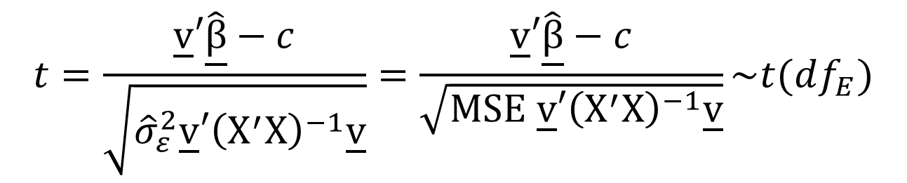
H₀: v’β = c
H₁: v’β ≠ c
Planned Comparisons
Typically we don’t know . So we have to use the statistic:
$$t=\frac{\underline{\text{v}}′\hat{\underline{\text{β}}}−c}{\sqrt{{\hat{σ}}_{ε}^{2}\underline{\text{v}}′{\left({\text{X}}^{′}\text{X}\right)}^{−1}\underline{\text{v}}}}=\frac{\underline{\text{v}}′\hat{\underline{\text{β}}}−c}{\sqrt{\text{MSE} \underline{\text{v}}′{\left({\text{X}}^{′}\text{X}\right)}^{−1}\underline{\text{v}}}}\sim t(df_{E})$$

Slide 37
H₀: v’β = c
H₁: v’β ≠ c
Planned Comparisons
Typically we don’t know . So we test the hypothesis with the t-statistic:
~
Or if it is a 2-tailed test:
~

Slide 38
Planned Comparisons in 1-way ANOVA
where
Then tests from previous slide simplify to
~
~

Slide 39
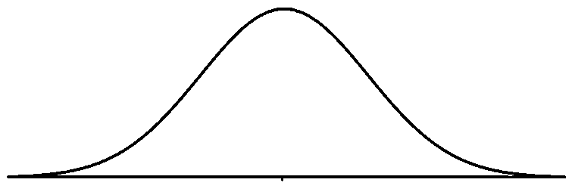
Planned Comparisons in 1-way ANOVA
which is same as:
testable
Suppose:
Then:
t(28)
So:
reject
reject
.005
.005
Reject H₀
-2.763
2.763

